Slide 1
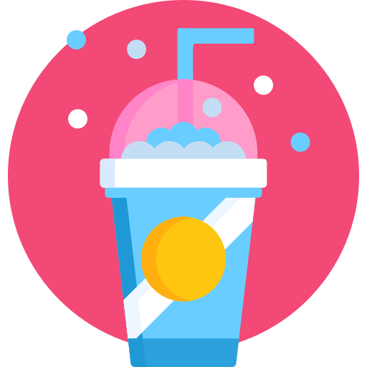
Slooshys
The Taste of Freedom

Slide 2
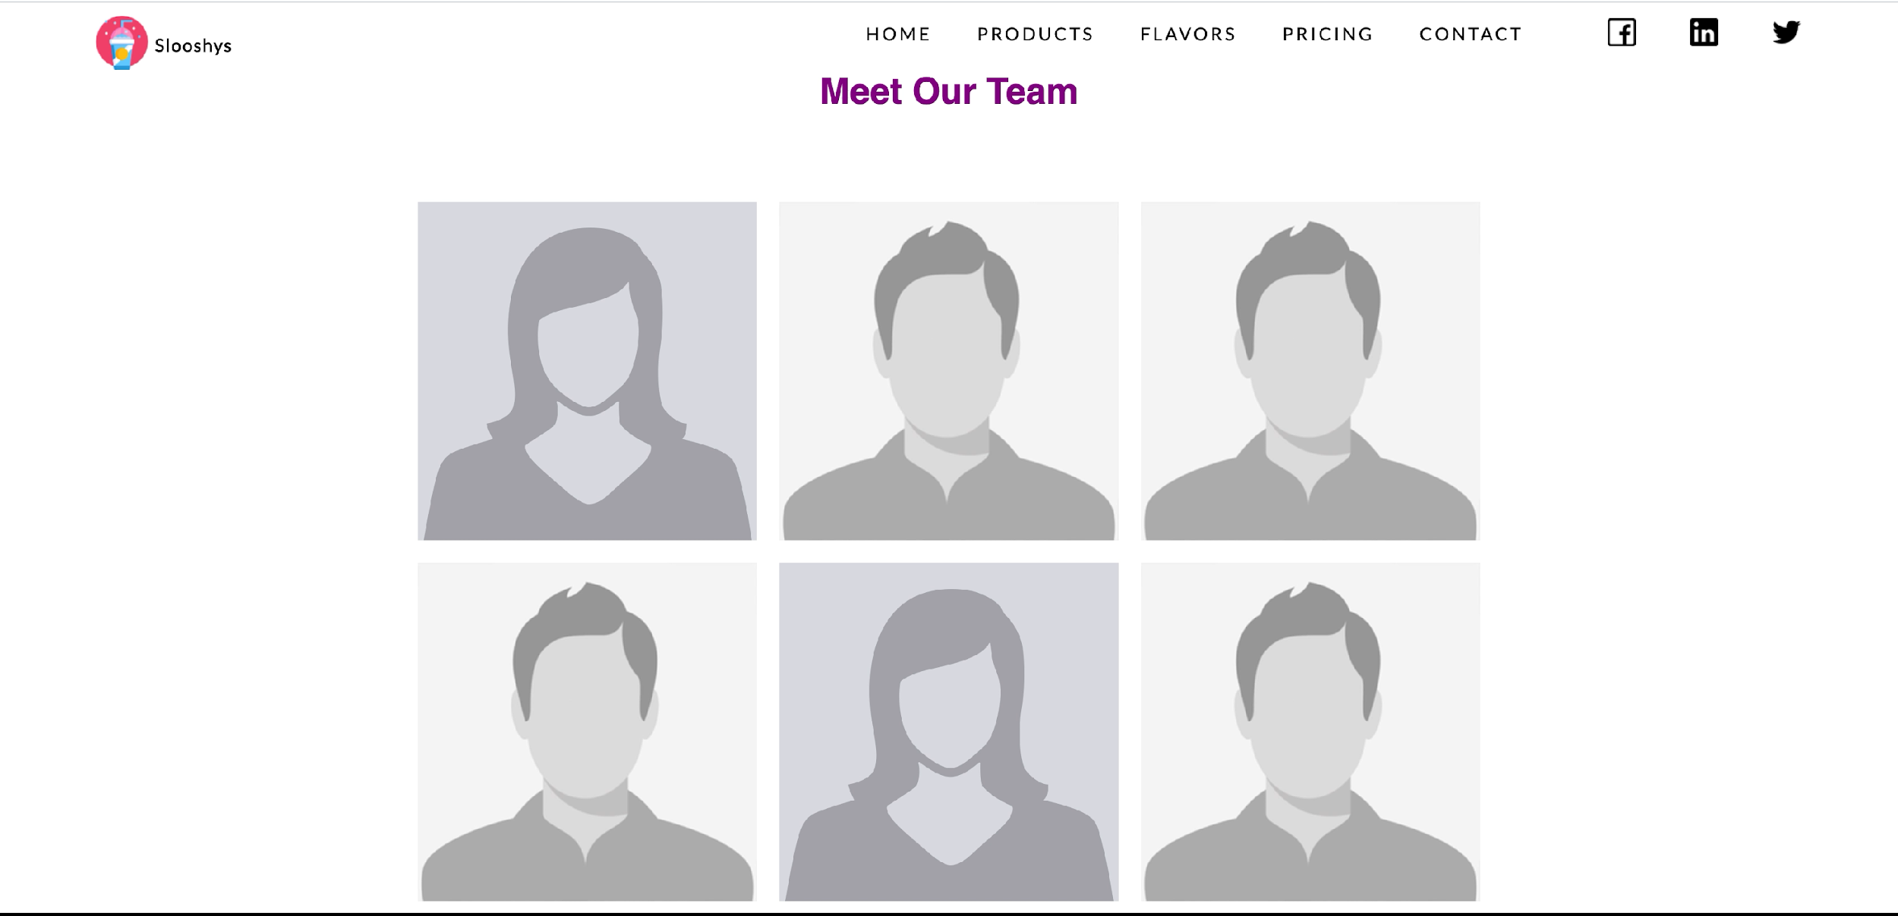
Who are we ?
Notes:
Each Team member introduces himself for about 20-30 seconds
Yara
Adnane
Ayman
Marwan
Hiba
Qaswar

Slide 3
Why we founded slooshys?

Slide 4

Problem

Slide 5

Notes:
Due to the current times, covid and the pandemic, most of us are hesitant to leave our houses. People are becoming more used to staying at their homes for long periods of time. Because school and work are from home, we are starting to develop a sedentary lifestyle. So it has become more of an inconvenience to leave the house to buy a soda, a slushie, or any drink you would want.

Slide 6
Solution !
Slooshys
Notes:
So we decided as a collective to start Slooshys and develop our very own machine that would make it possible to make almost any cold drink from the comfort of your home. With that we offer a plethora of flavours and options to support people’s preferences and physical-health. All that will be discussed by my peer shortly.

Slide 7
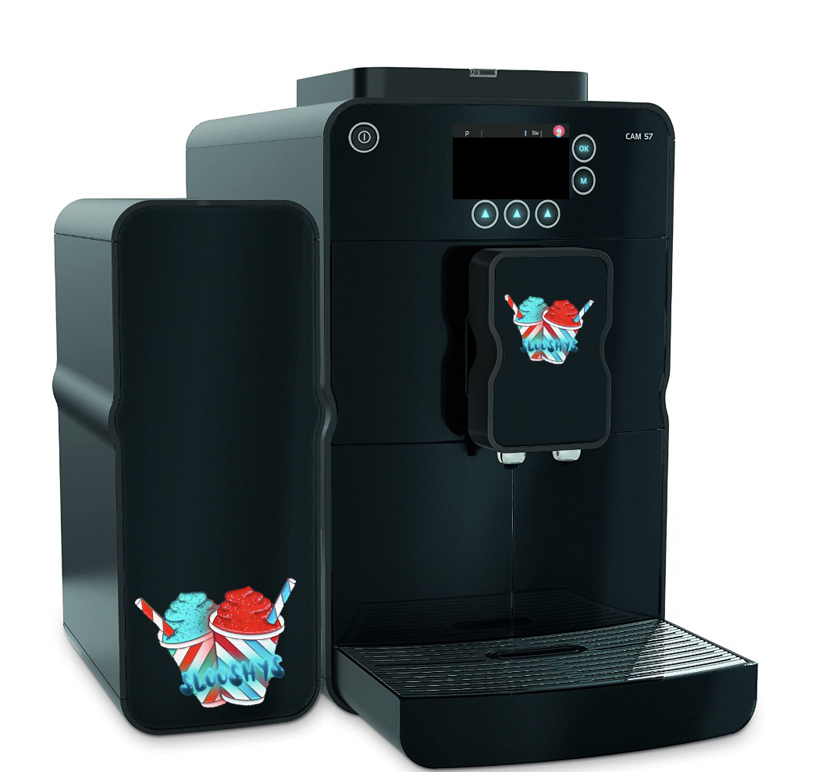
What are we offering ?
$499.99
Capsules are stored here
Smart
Uses rechargeable batteries
Eco-friendly
Notes:
We are offering a smart machine that is capable of making any cold drink!
Moreover, you can communicate with the machine by using our “Slooshy’s” mobile app, and with a click of a button from your device your drink will be served!
The machine can be easily powered by rechargeable batteries!
Our machine comes with a variety of options and flavors.
My peers will go thoroughly through the options and flavours with you in a bit.
As you can see, the machine is composed of two parts. The smaller part of the machine is the part where you can store the flavours, the flavours come in capsules. Thus, upon purchase the machine will be offered with free capsules.
In addition to that, our capsules are eco-friendly and does not cost a lot to manufacture.
You can buy our machine for $499.99!

Slide 8
Cold drinks that machine can make
Soda
Slushies
Smoothies
Energy Drinks
Iced-Tea
Juice

Slide 9
Flavours
Pina colada
Grape
Orange
Lime
Citrus lemonade
Raspberry rush
Notes:
In addition to that the machine will come with different flavours to choose from :
Such as GRAPE, PINA COLADA, LIME AND THE CITRUS LEMONADE. These flavours will come to the customer in a capsule form so that they will have some fun creating their favorite slooshy using our machine.

Slide 10
How are we making profit ?
Notes:
As you know we have a machine that makes Soda/Slushies/Smoothies/Energy drinks
to satisfy all tastes we also offer single products that customers can buy if they are not interested in the monthly subscription that the machine comes with
(Proceed to introduce the products and their price)
buy 3 get 1 free (to incentivize customers to buy more)
we also encourage our customers to get the monthly subscription as it is cheaper for the long term and helps protect the enviroment as our machine is eco-friendly (it does not produce waste and the capsules used to make the drinks are 100% organic )
We also offer a fidelity card to customers who pay for more than 6 months

Slide 11
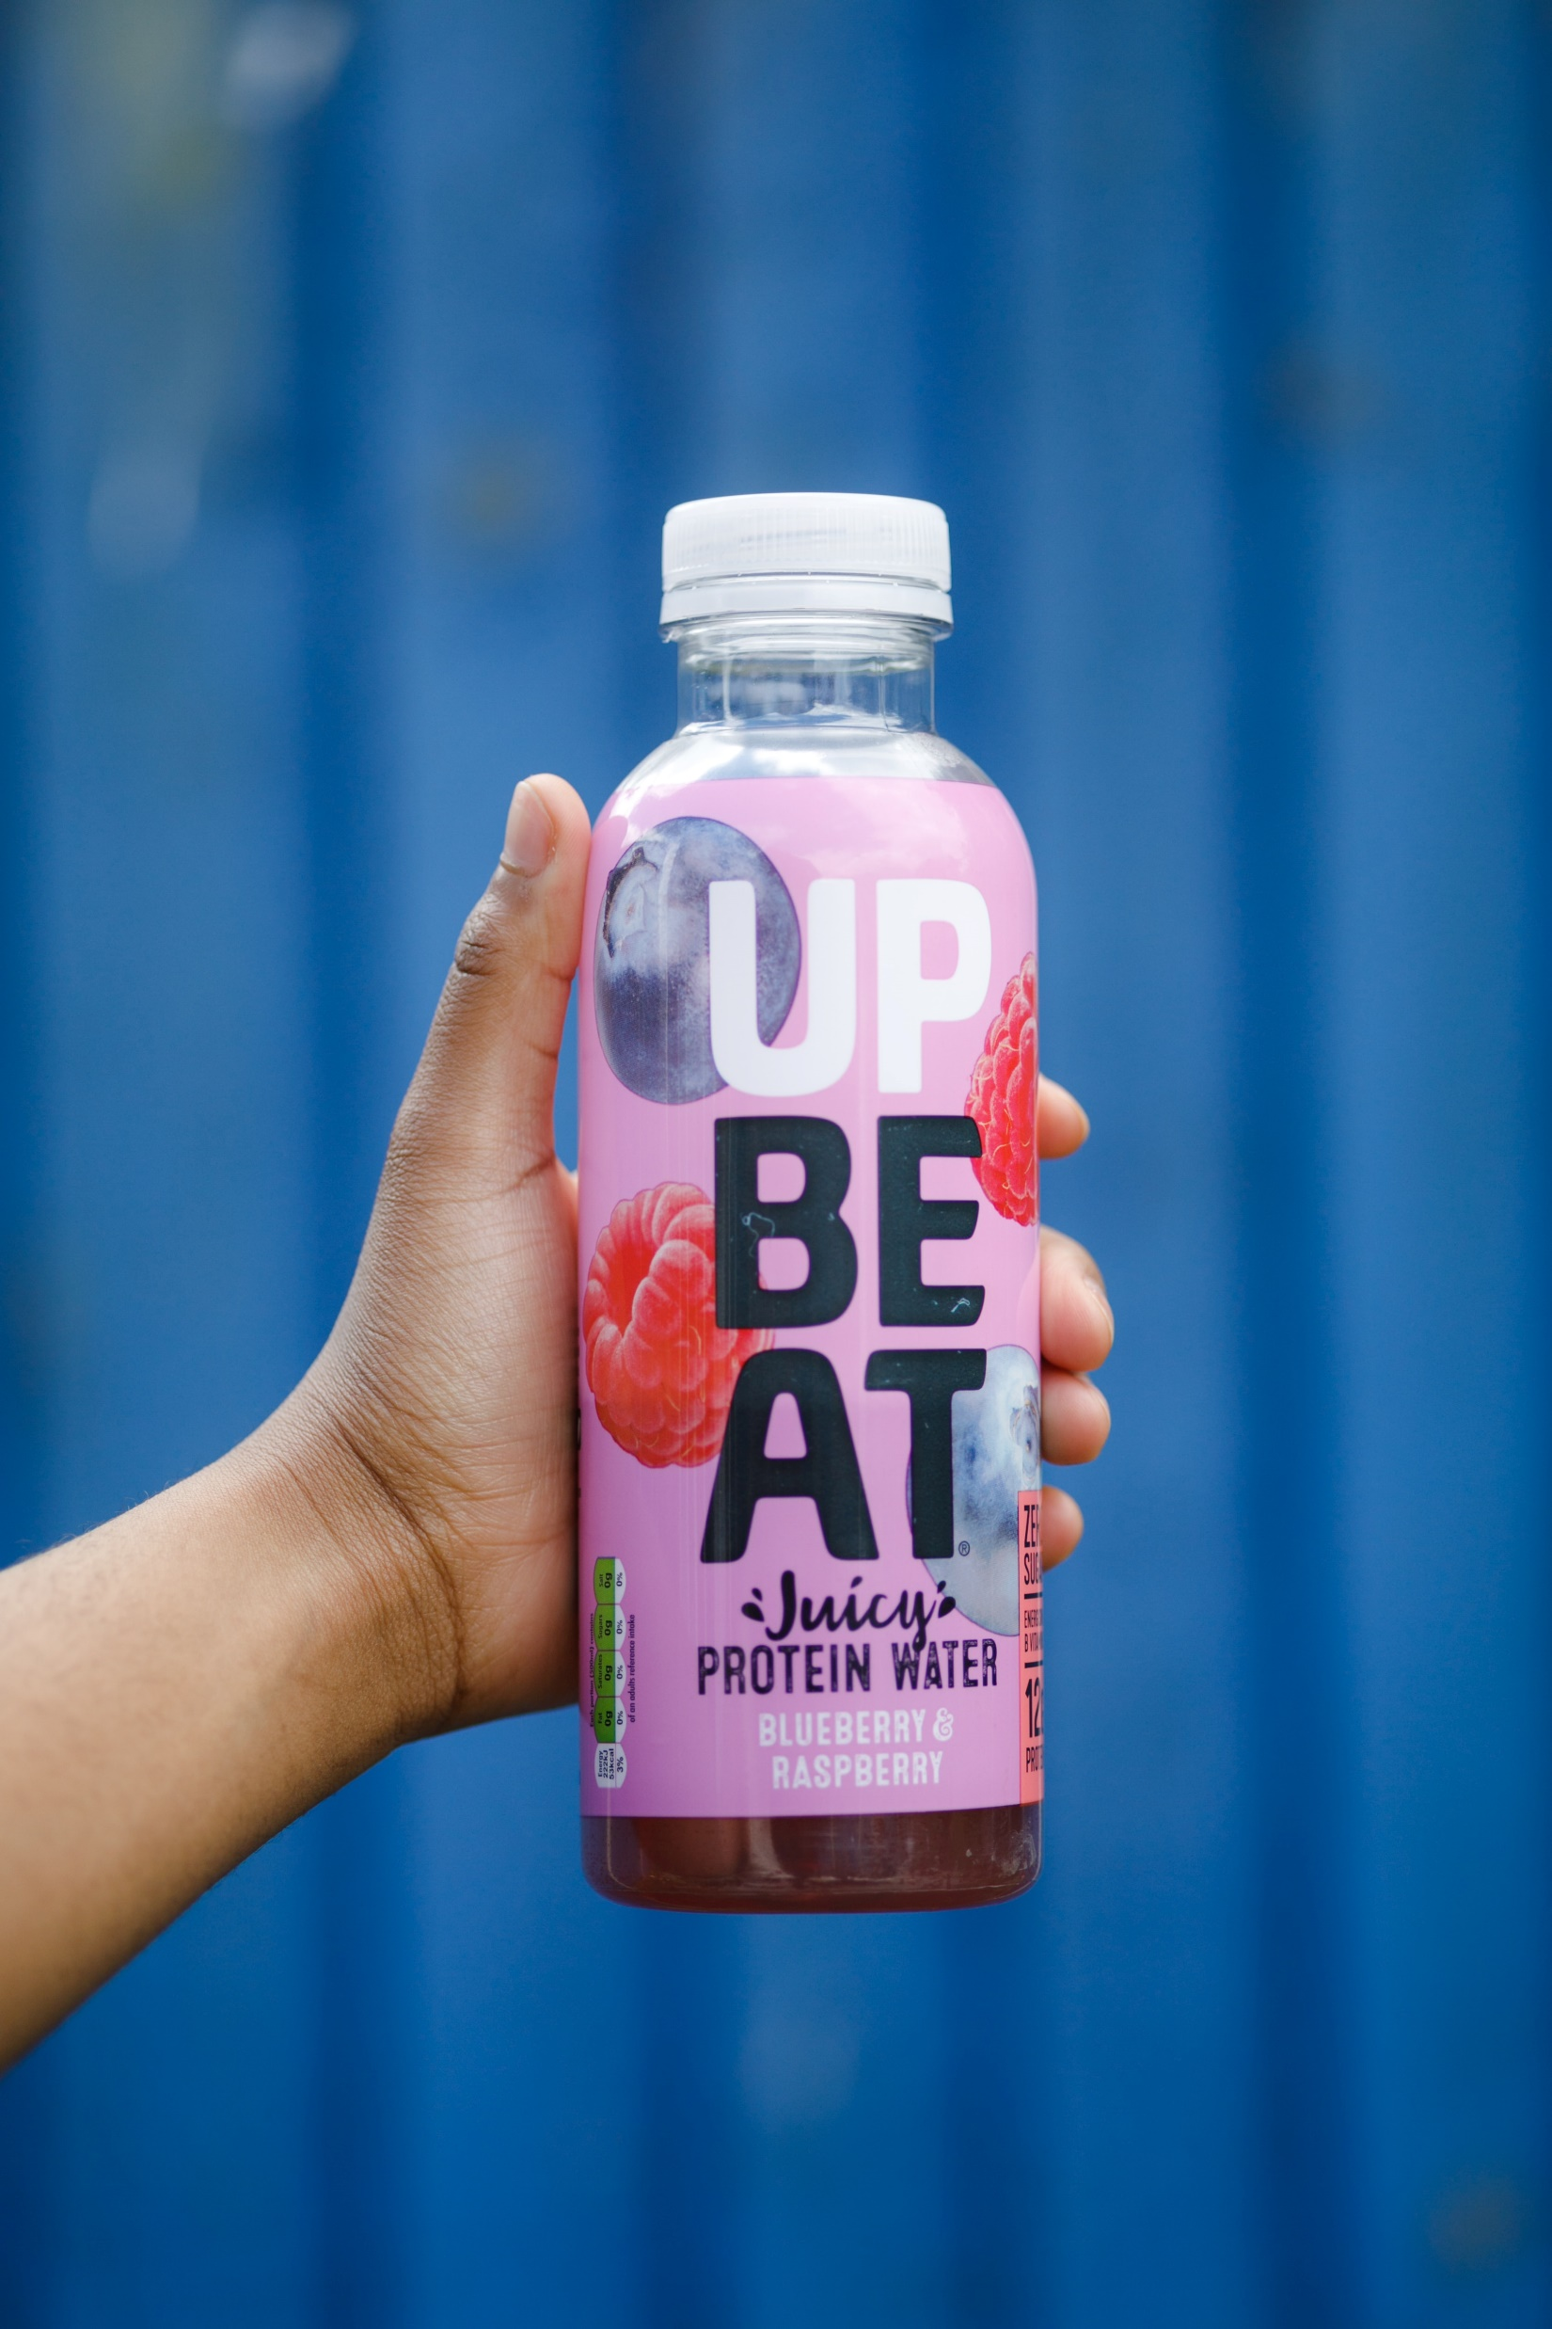
Options
Protein Drink
Notes:
We are also offering various drink options: we first have the
Protein drink: it is a fusion of blueberry and raspberry

Slide 12
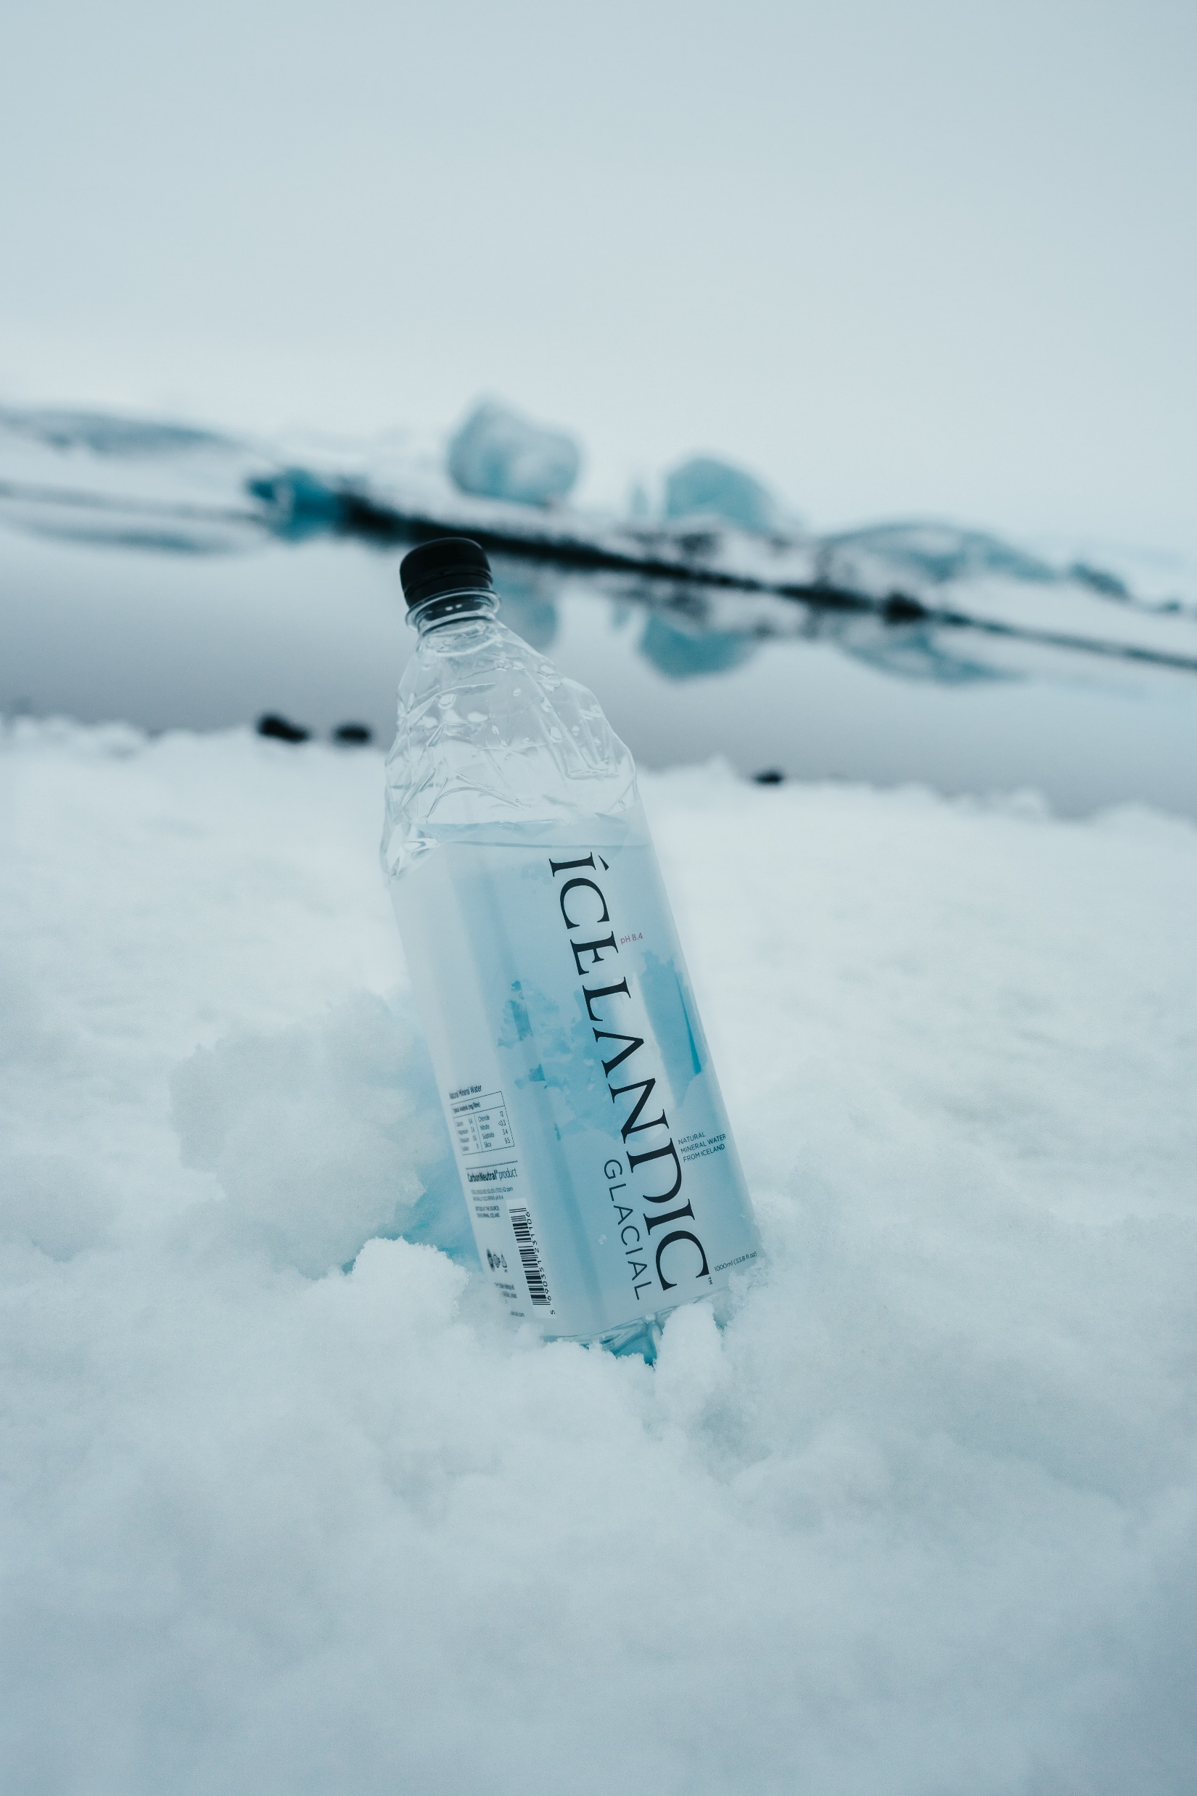
Options
Icelandic Water
Notes:
Icelandic water : a drink with zero calories and zero sugar !!!

Slide 13
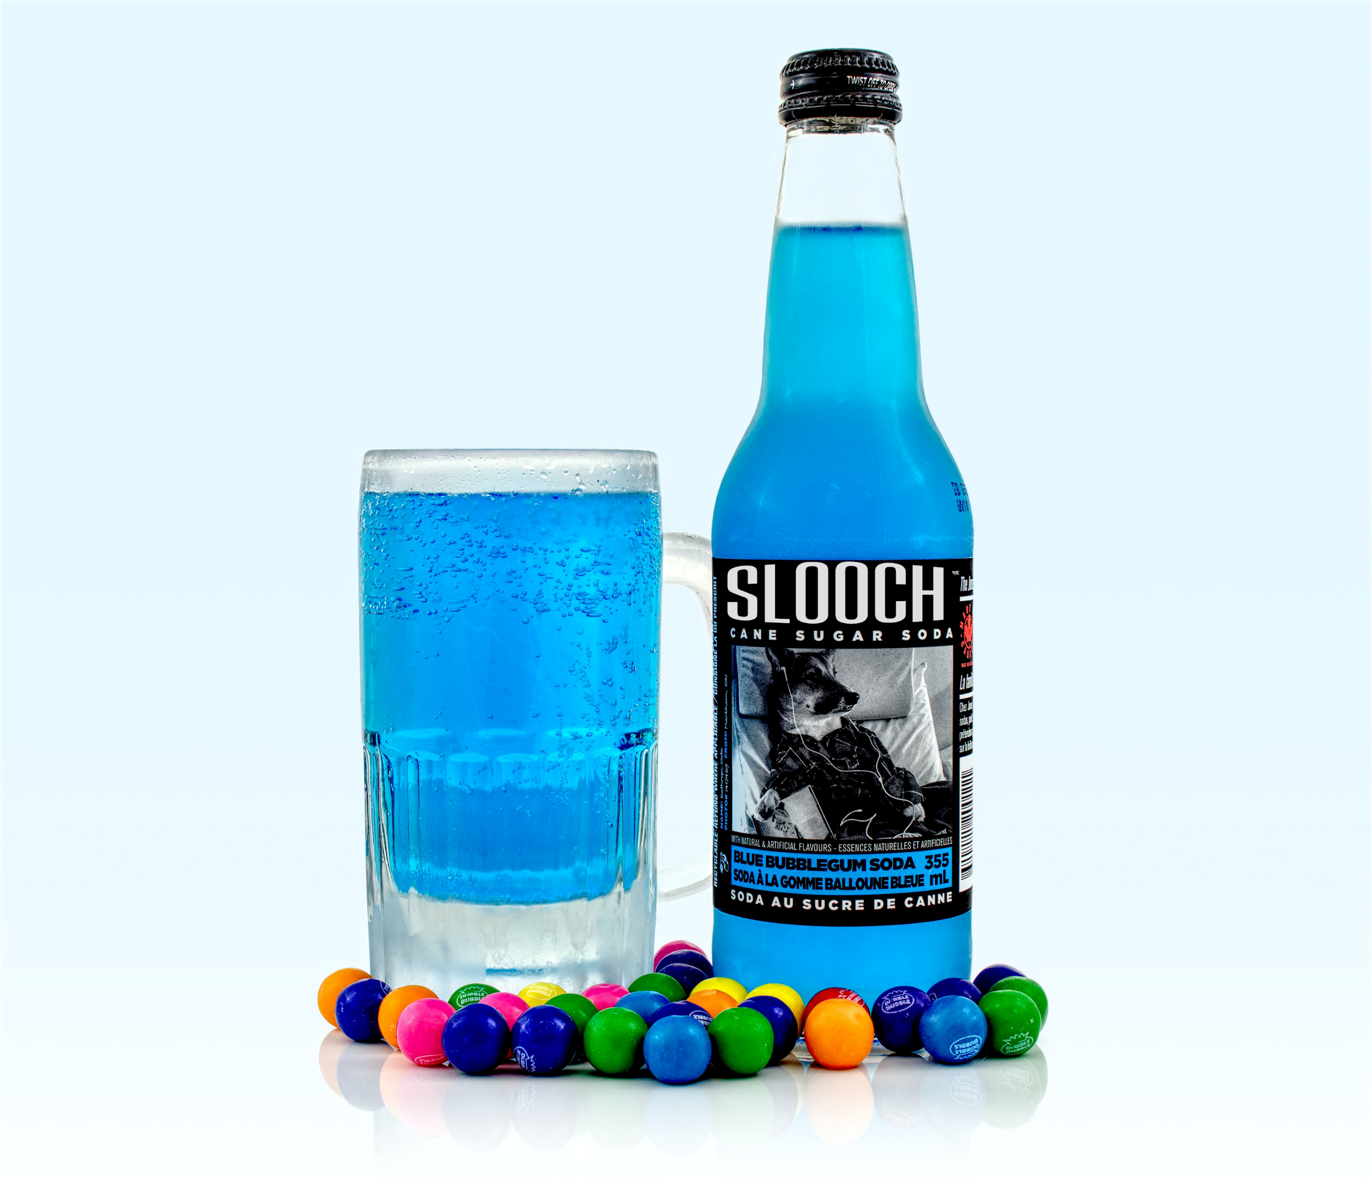
Options
Hype Soda
Notes:
The hype soda: for a bud-tingling effect

Slide 14
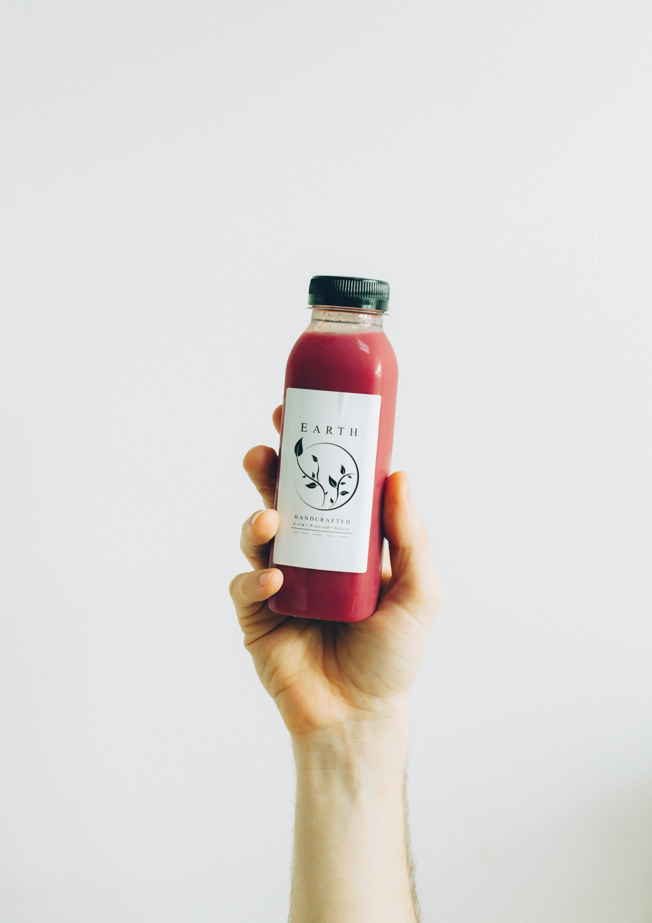
Options
Energy Drink
Notes:
And finally the energy drink : a pressed juice with no added sugar that contains rich vitamins and nutrients

Slide 15


Slide 16


Slide 17
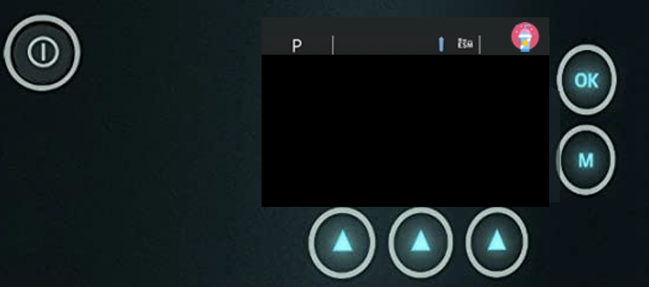
How the machine works
Step 1:
Click here!
Notes:
So some of you might wonder how the machine works

Slide 18
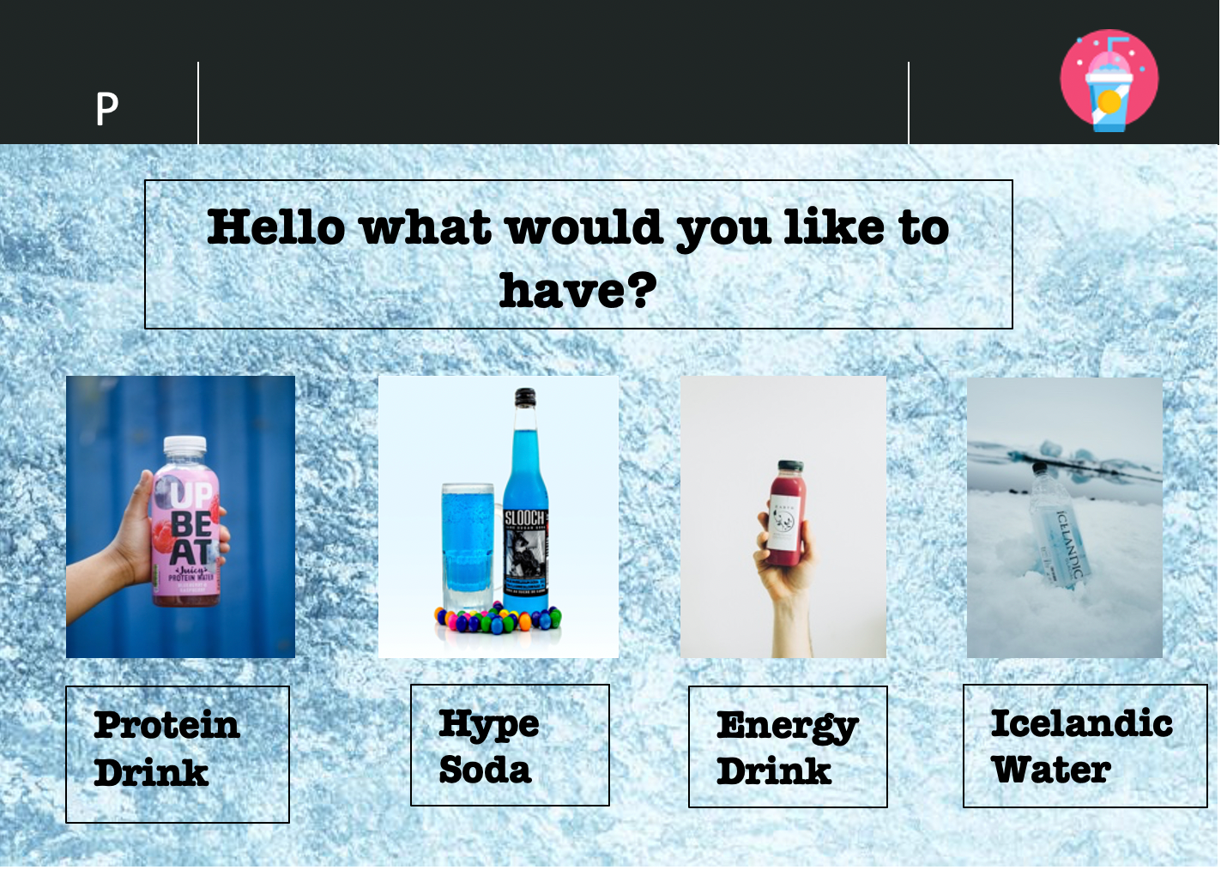
Step 2:

Slide 19
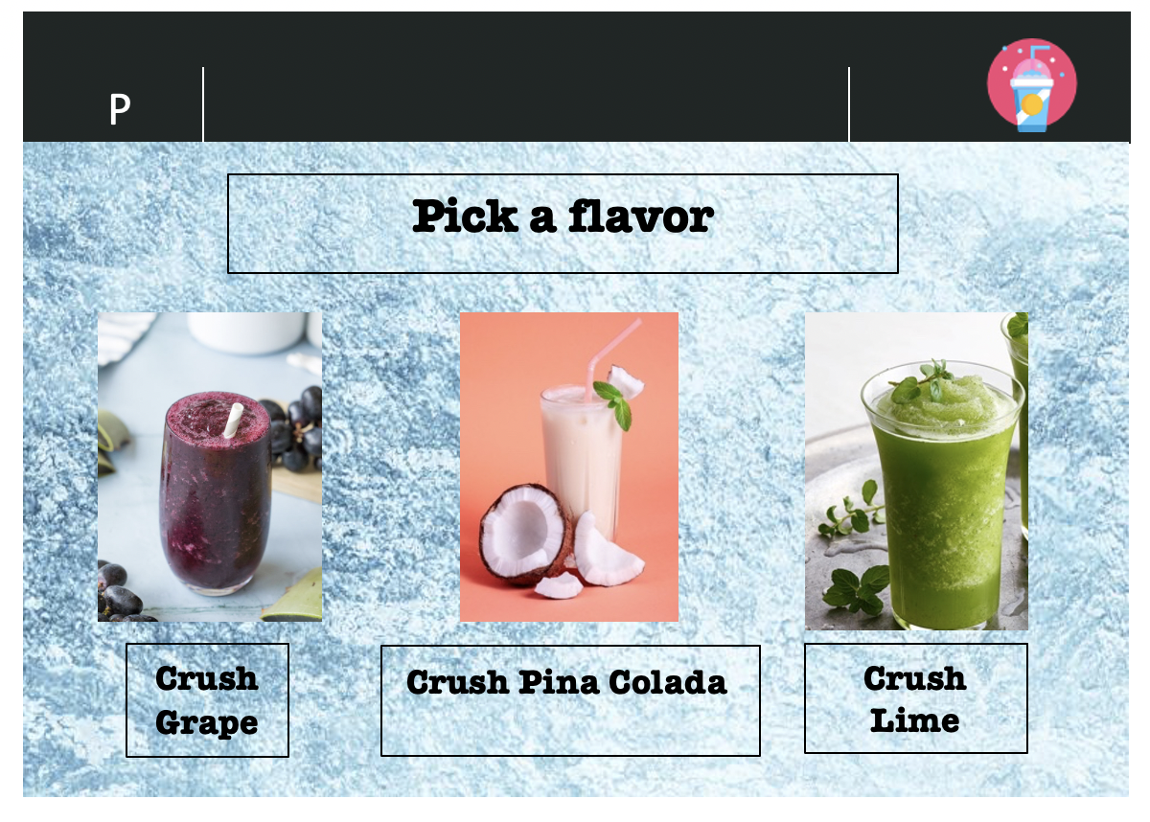
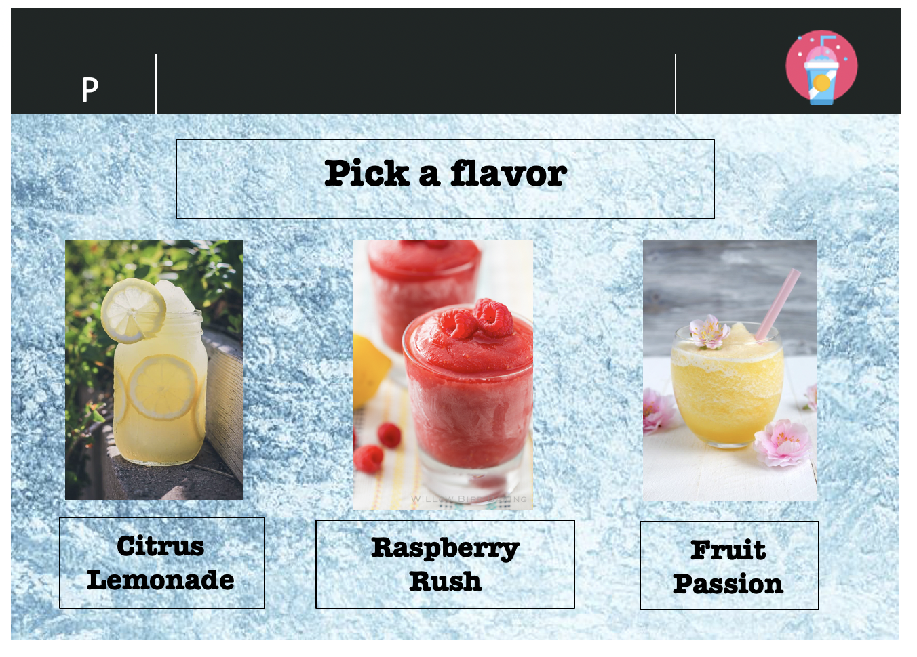
Step 3:

Slide 20
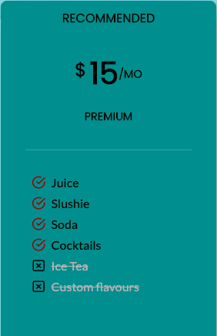
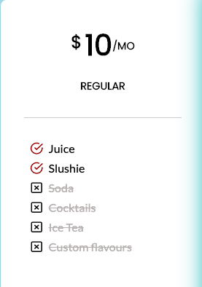
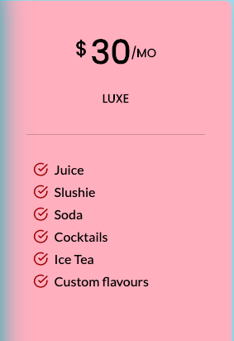
Plans
Notes:
Slooshys has been created to fulfill a simple vision. To offer high-quality products at low prices.
To achieve this vision, we fixed objectives for the future. Our mission is to make profits so Slooshys can prosper and develop through time. We have a two-part plan.
I’m going to present to you the first part.
We have a subscription plan that is divided into 3 categories which are Regular, Premium and Luxe. The prices are fixed at respectively 10, 15 and 30 dollars per month.
Every plan comes with features and the more you can invest, the more you get.
First of all, the regular plan has 2 basic features that are juice and slushie.
Then, the premium plan has 4 features and finally, a Luxe plan which contains every feature plus custom flavours that our client can personally chose.
We offer our customers a free month trial for the Regular plan so they can have a taste of freedom.
Dear investors, I’ll let my friend Ayman talk you into the second part.

Slide 21

Phone App
Notes:
But what if i’m not home you might ask? Or what if i don’t want to get out of bed?
Introducing: The Slooshys™ app.

Slide 22
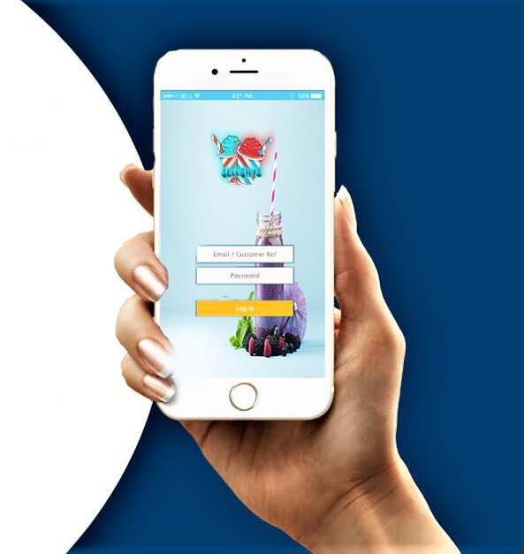
Slooshys App
Notes:
The app has 2 main functionalities:
1- You can order your flavors and packages and get them shipped straight to your doorstep
2- It also connects to your machine, so you can make your drinks from wherever you are! In your bedroom at 8am craving a cup of orange juice? Playing sports in a hot sunny day needing a cold smoothie? With just a click of a button, your drink will be waiting for you to come back

Slide 23

Notes:
The app is also a way to contact customer support directly for any kind of issue regarding the machine, flavors, or your overall experience! We’d love for you to give us feedback about how refreshing the slushie is, or how delicious the flavors are!

Slide 24
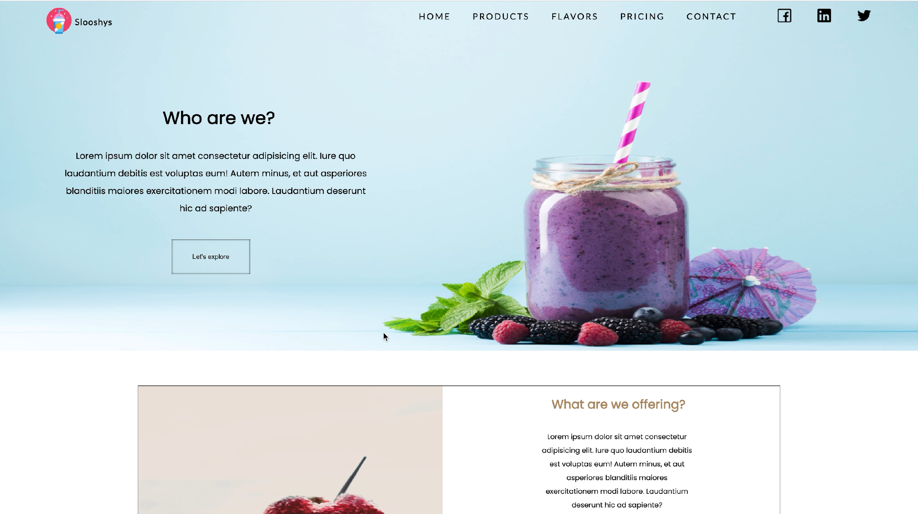
contact@slooshys.ca
Notes:
You can contact us on our email

